Slide 1
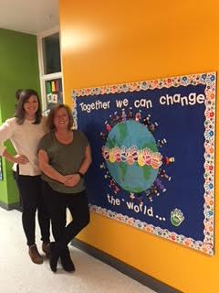
Mrs. Hansch & Ms. Long Second Grade Rooms 102 & 103
Welcome!!
Theme:

Slide 2
Website
https://www.stlukeshoreline.net
Parent Communication (Newsletters)
Spelling
Class Policies (rules and routines)
Daily Schedule
Sacraments
Curriculum Map
Photo Gallery
Helpful Links

Slide 3
Communication
Classroom Communication:
Weekly Newsletter (email and posted on the website)
Email is the best way to communicate with us (unless is something for that day – call office)
School communication:
Read the Thursday packet from the office
Student progress:
Conferences (develop goals and follow-up in Spring)
PowerSchool (updated regularly)
Progress Reports and Report Cards
Meetings as requested by parent or teacher(s)

Slide 4
Nuts & Bolts
Parent Homework (all about your child)
Sacraments Form
Turn in by 9/24
Let us know if your child is not participating
Extra forms on table
* Check Directory (initial directory page)
* Comfort letters
Turn in to homeroom teacher
Turn in by 9/24

Slide 5
Assessment

Slide 6
Homework
Expectations
20 minutes plus 10 minutes independent reading
Independent work with parent supervision
Types of homework
occasional unfinished school-work
spelling packets
math homework pages and/or
reteach/extension worksheets
IB projects
monthly reading logs

Slide 7
Sacraments
All second graders will be prepared for Sacraments
Susan Burdett is our Faith formation/Sacraments Coordinator. She will lead the sacrament meetings and is in-charge
Remember to return sacraments form (with baptism certificate if necessary)
Important Dates:
November 15th, First Reconciliation parent only meeting in the church
January 12th, 10:00a.m., First Reconciliation
April 4th- First Eucharist parent only meeting in the church
May 2nd- First Communion Rehearsal @7pm in the Church. Both parents and child need to attend
May 4th- First Communion Mass @10am in the Church. Students arrive at 9:30 in the auditorium

Slide 8
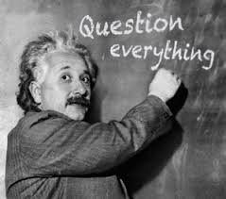
Any Questions?

