Slide 1
Welcome to
1st grade!
What you need to know to support your 1st grader this year…

Slide 2
1st grade procedures are all about:
Learning through inquiry & exploration
Learning study skills
Practicing organizational skills
Working hard
Working collaboratively in groups
Learning how to communicate effectively
Staying safe and healthy
Treating others with respect

Slide 3
A bit about Ms. Long:
From Boise, Idaho
Lived in Seattle for 5 years
Attended Catholic schools from K at St. Mark’s to Masters Degree from University of Portland
10th year teaching; 3rd year here at St. Luke
Loves: reading, hiking, baking, the color coral, TEACHING :)

Slide 4
Class Website:
https://www.stlukeshoreline.net
Parent Communication - newsletters
Class Policies - ABC’s, schedule, Amazon class wish list
Curriculum Map - curriculum, IB units
Websites & Links
Photo Gallery

Slide 5
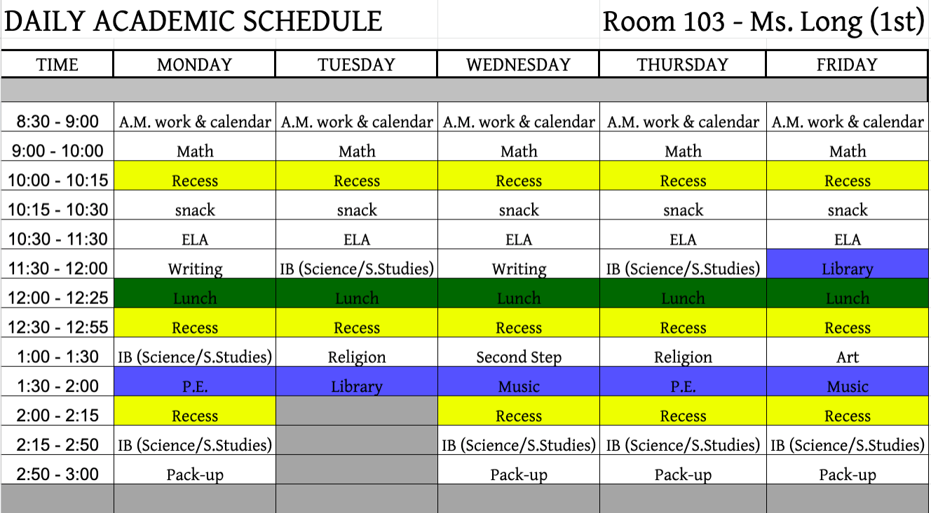
Schedule:

Slide 6
Communication:
Classroom & School Communication:
Weekly Newsletter (email and posted on the website)
Read the Thursday packet from the office for school news
Email is the best way to communicate with me, dlong@stlukeshoreline.org
To find a healthy work-life balance, I am available between 7 a.m. and 5 p.m. Monday - Friday via email or on the phone
I will make it a priority to respond to your email within 24 hours (if on the weekends, by Monday afternoon)

Slide 7
Communication (pt. 2):
Student progress:
Graded work will come home throughout the week - look in “Left at Home” side of Homework folder
IB work will be kept in student’s IB Portfolio (will come home in June)
Conferences (develop goals and follow up in Spring)
PowerSchool (updated with grades regularly)
Progress Reports and Report Cards 6 times a year
Meetings as requested by parent or teacher (please use email to schedule)

Slide 8
Carpool:
Morning: Drop your child off in carpool OR meet us in line outside on the playground at 8:20. We’ll line up along the gate by the Pre-K toy area. Say goodbye to your child outside; we’ll walk in together as a class.
Afternoon: Meet us by the portables to pick up your child. You can walk up and meet us in line, or wait at the rope in carpool. For safety reasons, I ask that your child say goodbye to me with a handshake, high five, hug, etc. before they join you
Extension: If you haven’t picked your child up by 3:15 (2:15 on Tuesdays), they’ll be walked down to Extension - pick them up there.
Please email me if there’s a last minute change in plans (e.g. your child
is going to Extension, picked up by Grandma, etc.)

Slide 9
Uniforms:
Socks must be worn with shoes. Knee highs, socks, or tights must be in uniform colors (navy, black, grey, or white)
Shoes - flip-flops not allowed & appropriate for school. Please bring an extra pair for P.E. classes (these will stay here at school)
Shirts must be tucked in during the school day
Free Dress days will be noted on the school & class calendars - see Handbook for details

Slide 10
Homework:
You can expect your child to have 20 minutes of homework a night
10 minutes of reading (have them read aloud to you)
Nightly Math homework from My Math program - due next day
Weekly SuperKids Spelling homework OR ELA homework (per unit: 1 week of Spelling, 1 week of ELA) - due at end of the week
Students earn DOBs on their Award Charts for turning in their homework
If your child is absent, a folder will come home with a list of work to complete & a due date (typically 2 school days after they return)

Slide 11
Volunteers:
Help in the classroom with centers, activities, Library,
Help prepare materials at home
Chaperone class field trips
Help around the school with Library classes, supervising recesses, fundraisers, etc.
Fill out volunteer survey & return to Ms. Long by Monday, Sept. 9th
ALL volunteers MUST complete a Safe Environment Class to volunteer
There is a Safe Environment Class on Saturday, Sept. 21st at 1 p.m. here at St. Luke

Slide 12
Classroom rules
We’ll create a class covenant (with expectations) together the 1st week of school
Everyone will sign this covenant, & be held accountable to them
Ms. Long’s rules:
Follow directions quickly & quietly
Respect other people, yourself, and your school
Raise your hand to speak
Be kind with your words and actions to stay safe

Slide 13
Supplies:
Please ensure that all of these items are in your child’s desk:
1 Elmers glue 1 set of colored pencils
2 dry erase markers 1 pair of scissors
1 box of crayons 1 black sharpie
1 highlighter 1 package of wide tip markers
1 package of fine tip markers 1 glue stick
2 sharpened pencils 2 pencil top erasers
1 ruler 1 large eraser
6 heavy folders with bottom pockets 1 pair of headphones
1 set of watercolor paints 1-inch binder w/ clear front sleeve
1 spiral notebook 1 set of oil pastels
If any items are missing, please send them in by Friday. Thank you!

Slide 14
Birthdays:
We will celebrate birthdays together in class on the day of their birthday (or if on a weekend, Friday or Monday - you let me know!)
If your child would like to bring in treats, they are welcome to (not required)
If your child has a summer birthday, no worries! We’ll celebrate ½ birthdays, too
No passing out invitations during school hours

Slide 15
Snack:
We’ve a late lunch this year (at 12 p.m.)
Please send your child with a hearty, healthy snack each day (especially if they’re having hot lunch)
We’ll take a snack break after recess at 10:15 every morning
Please no peanuts or nuts!

Slide 16
Prayer:
We pray at least 3 times a day – in the morning (appx. 8:30), before lunch, & at the end of the day (appx. 2:55 p.m.)
A student prayer leader picks a prayers & leads us in saying it

Slide 17
Classroom Jobs:
Classroom jobs help keep our classroom clean, organized, and running smoothly!
Jobs are posted on the back bulletin board on the “owl treehouse”
Jobs change every 2 weeks; throughout the year, everyone will do each job
Responsibilities are posted by the tree

Slide 18
Nuts & Bolts:
Parent Homework (all about your child) - due Mon. Sept. 9th
Picture forms; complete ASAP. Picture Day is Thursday, Sept. 12th
Fundraiser packets - take home tonight
Comfort letters
Write & turn in to homeroom teacher

