Slide 1
A Parent’s Prayer
Loving God,
You are the giver of all we possess, the source of all our blessings. Thank you for the gift of our children. Help us to set boundaries for them, and yet encourage them to explore. Give us the strength and courage to treat each day as a fresh start. May we help them to grow in faith, hope, and love, so they may know peace, truth, and goodness.
May their ears hear your voice.
May their eyes see your presence in all things.
May their hearts be your dwelling place.
May their hands do works of charity.
May their feet walk in the way of Jesus Christ, your son and Lord.

Slide 2
5th Grade
2021 - 2022
By Ms. Bakamis & Mrs. Smith

Slide 3
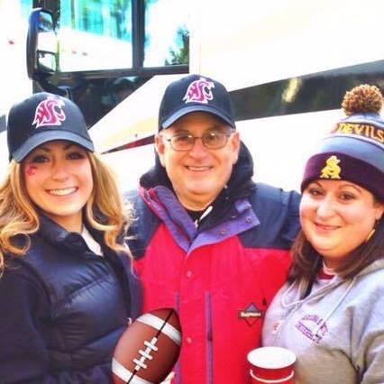
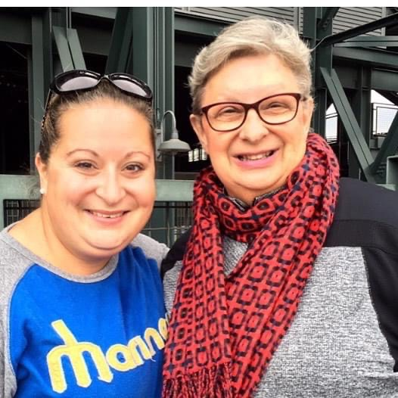
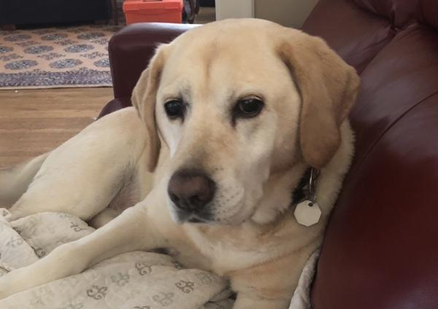
Ms. Bakamis Introduction
Educational background
Has worked for the Archdiocese of Seattle for 11 years
Lives in Capitol Hill with sister (Anne) & yellow lab (Nikki)

Slide 4
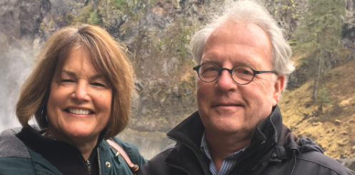
Mrs. Smith Introduction
Educational Background: Catholic grade school, high school, UW Graduate.
Fun Fact: Went to grade school
with Mr. Boyle.
Catholic educator in Archdiocese of Seattle for 25 years.
Lives in West Seattle with husband,
Leo.

Slide 5
St. Luke School-wide Learning Expectations (SLEs)
Inquiring Minds
Hearts for Jesus
Hands for Service

Slide 6
Communication
Weekly Newsletters
PowerSchool Updated bi-monthly for each subject starting later next week
Best way to contact us is via email. We will respond within 24 hours.
rsmith@stlukeshoreline.org
kbakamis@stlukeshoreline.org

Slide 7
Schedules & Routines
Students will receive their weekly schedules during the second full week of school
Daily schedules will be posted in each classroom
Each Homeroom teacher will go over classroom routines with their students
For Reading & Writing Ms. Bakamis & Mrs. Smith will also go over routines & expectations with both classes

Slide 8
Carpool
Carpool Information
Morning Drop-off Times (depends on last name)
Afternoon Pick-up Times (go with the youngest sibling)
Our regular time is: 3 pm OR 2 pm (on Tuesdays)
Our Pick-up Lane: LANE 5

Slide 9
Questions?

