Slide 1


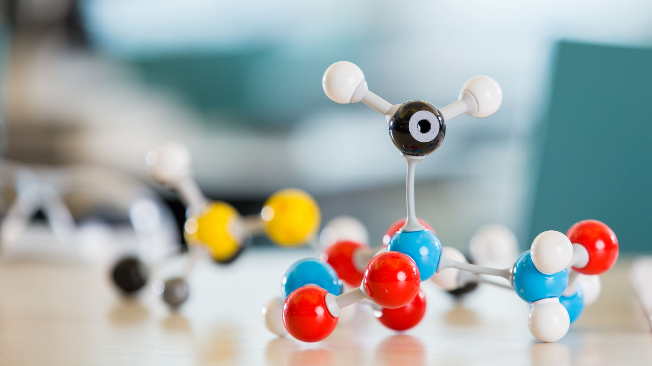
Welcome to 7th Grade Science

Slide 2

Unit 1: Me, a Scientist?
We will learn to...
Measure in science
Write in science
Read in science
How to conduct labs
Follow the scientific method

Slide 3

Unit 2: Energetically Me
We will learn about...
Gravity
Friction
Inertia
Magnetic Forces
Kinetic and Potential Energy

Slide 4
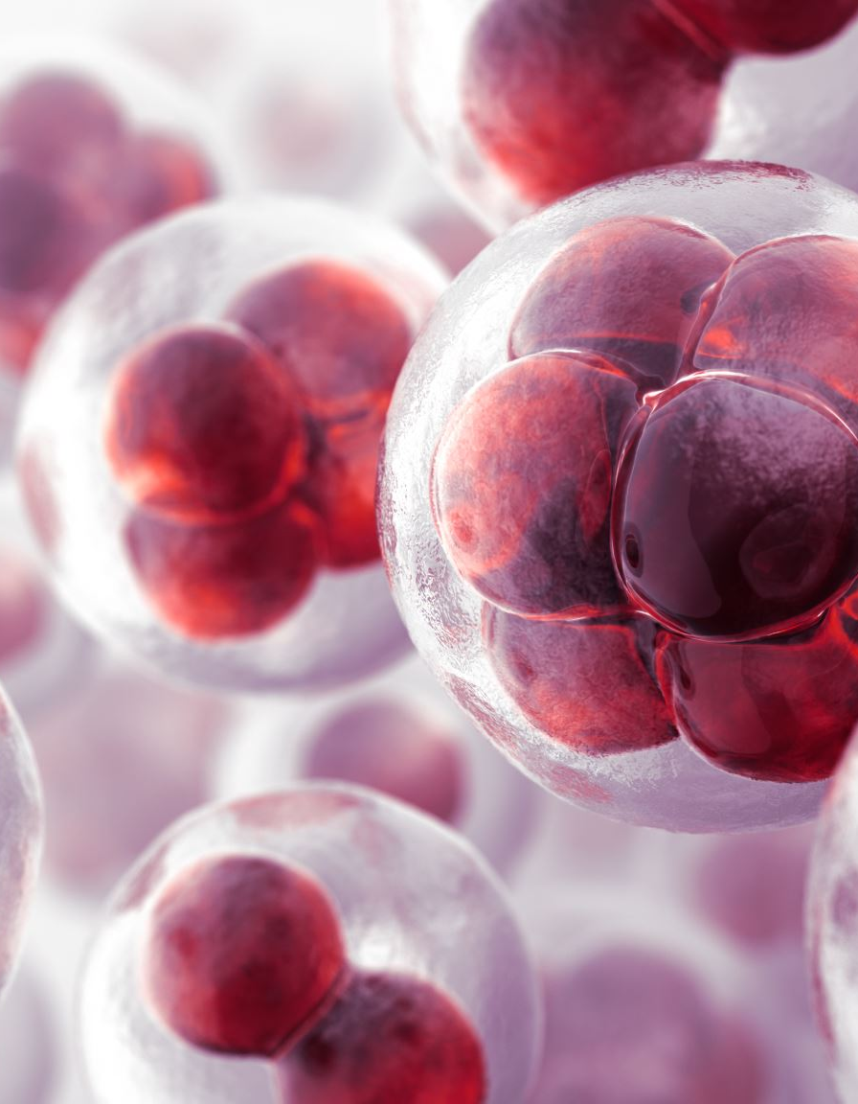
Unit 3: How is the Body Connected?
We will learn about...
Human Body Systems
Cellular Respiration
Importance of Nutrition
Anerobic Respiration
Aerobic Respiration

Slide 5
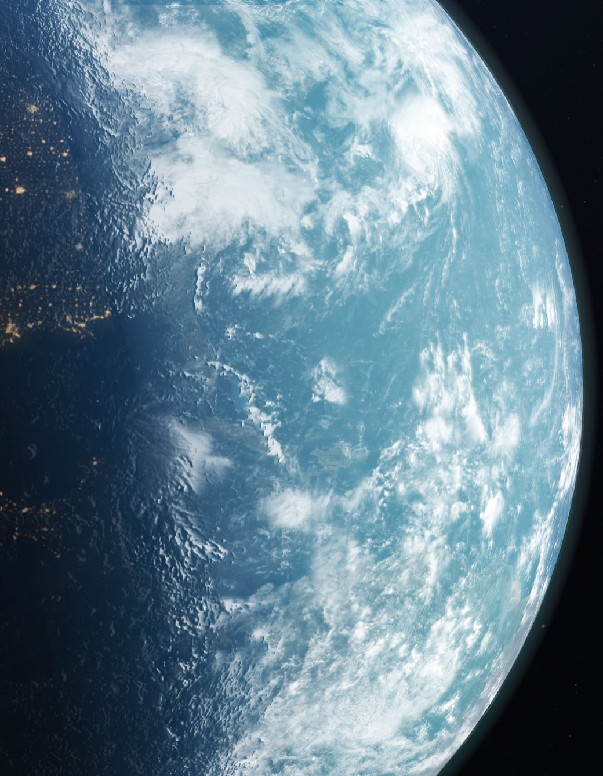
Unit 4: Earth Across the Ages
We will learn about...
Changing ecosystems
Layers of the Earth
Rocks
Earth's Interior
Pacific Northwest Overtime
How historical events shaped the Earth

Slide 6
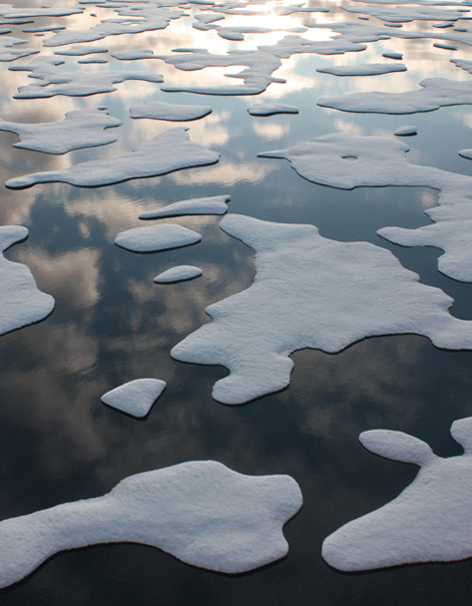
Unit 5: Disasters, Naturally
We will learn about...
Plate Tectonics
Earthquakes
Tsunamis
Volcanoes
Climate Change
This Photo by Unknown author is licensed under CC BY.

Slide 7
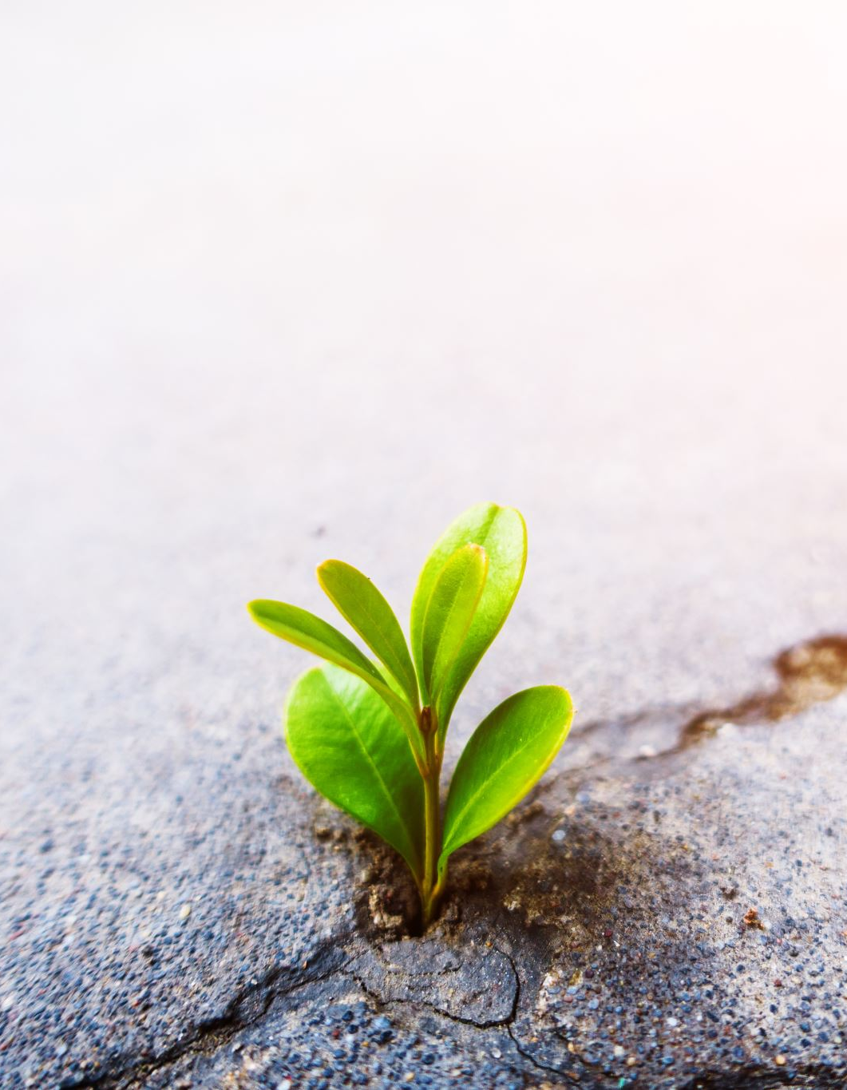
Unit 6: Biomes around the World
We will learn about...
The different types of Biomes
Interactions between different biomes
Key characteristics of biomes
The importance of endangered species in different biomes

Slide 8
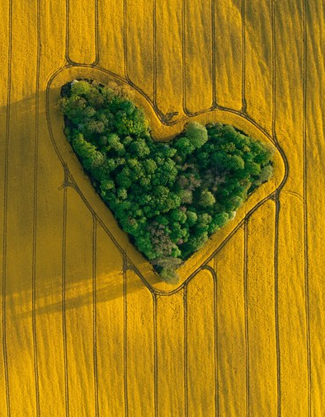
Unit 7: Land Use and Topography
We will learn about...
Land Usage in Washington
Land Usage in the United States
How to read maps
Benchmarks on maps
How land can be better utilized
This Photo by Unknown author is licensed under CC BY.

Slide 9

What can you expect?
At least one big project per unit
Quizzes during every unit
Taking notes
Conducting experiments
Working with your classmates
Written and multiple choice exams

