Slide 1
Welcome to
1st grade!
Mrs. Edmonds
Ms. Foo

Slide 2
Class Websites:
Mrs. Edmonds' and Ms. Foo's 1st grade pages
Schedule
Communication - parent communication, Essential Agreements, & Class policies
Homework - links to Weekly Lesson Overviews
Photos - photo gallery of students & student work
Notes:
Curriculum - curriculum map, PYP scope & sequence, assessment, and resources (websites & links)

Slide 3
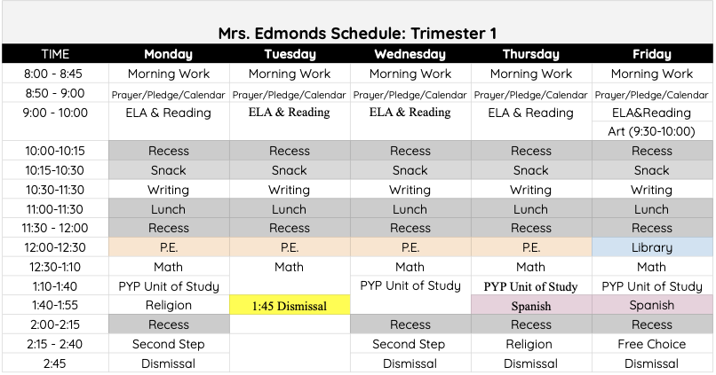
Mrs Edmonds’ Schedule:
Weekly Newsletters will be emailed out and posted on our class website at the beginning of each week.
They will follow this schedule, and provide more specific details of what we’ll be learning, assignments, due dates, and more.

Slide 4
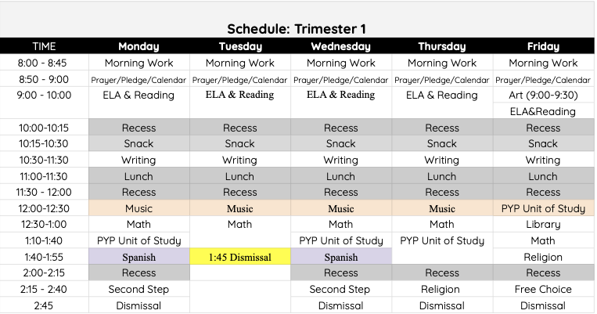
Ms. Foo’s Schedule:

Slide 5
Communication:
Communicating school & class information:
Class website - Mrs. Edmonds and Ms. Foo
Weekly Newsletter (email and posted on the website)
Thursday packet from the office - school news & updates
Email is the best way to communicate with us
To find a healthy work-life balance, we are available between 7 a.m. and 5 p.m. Monday - Friday via email
During school hours, we aren’t able to respond immediately.
For emergencies, please contact the office
We will make it a priority to respond to your email within 48 hours (if on the weekends, by Monday afternoon)

Slide 6
Communication (pt. 2):
Communicating student progress:
Work will come home throughout the week - look in “Left at Home” side of Take Home Folder (left side = leave at home, right side = return to school)
Conferences (develop goals during week of Thanksgiving and follow up in Spring)
PowerSchool (updated with grades at least every 2 weeks)
Progress Reports and Report Cards shared 6 times a year
Meetings by request from parent or teacher (please email us to schedule and provide a brief idea of what you’d like to discuss)

Slide 7
Being Ready to Learn:
Prepared with all supplies:
1. Backpack
2. Extra face masks (we recommend 5)
(2 plastic bags in backpack: 1 labeled clean, 1 labeled dirty)
3. Water bottle filled with water with name label
(Drinking fountains are not available only bottle fillers)
4. Lunch (or pre order hot lunch)
5. Snack
6. Take Home Folder in backpack everyday
(Your child will receive this folder on Wednesday)
Weather Dependent:
Coat/ Raincoat depending on the weather.
We got out to recess 3 times everyday!
Rainboots (optional)
Please don’t bring toys, stuffed animals, lip gloss, or distracting jewelry.

Slide 8
1st grade procedures are all about:
Learning through inquiry & exploration
Learning study skills
Practicing organizational skills
Working hard
Working collaboratively in groups
Learning how to communicate effectively
Staying safe and healthy
Treating others with respect

Slide 9
Class Covenants:
Together, we will create a class covenant (with rules & expectations of behavior) the 1st week of school

Slide 10
Homework:
You can expect your child to have appx. 20 minutes of homework a night
10 minutes of reading (have them read aloud to you)
Daily Math homework from My Math program - due next day
Weekly SuperKids Spelling homework (Backpack pages) - due end of week
Weekly Science and/or Social Studies activity
Weekly Second Step home links or Religion reflections

Slide 11
Homework (pt. 2):
Check Take Home Folder in backpack daily.
Competed work will be sent home on the Keep at Home side of the folder.
Homework will come home on the Return to School side of your folder most days but not everyday.
Complete homework and return to school hopefully by the next day.
Read to your child 10-15 minutes every day. Later in the year your child will become the reader for this homework expectation.
Please have pencils, erasers and crayons at home to complete homework

Slide 12
Snack & Lunch
Please send your child with a hearty, healthy snack each day (especially if they’re having hot lunch)
We’ll take a snack break after recess at 10:15 a.m. every morning
Lunches will be eaten in the classroom
For hot lunch, please order online ahead of time. Lunches will be boxed & brought to the classrooms
Hot Lunch will begin on September 27th
Please be aware of allergies - no nuts!

Slide 13
Birthdays:
We will celebrate birthdays together in class on the day of the child’s birthday.
If your child has a summer birthday, please let us know if they would like to celebrate their half birthday.
If your child would like to bring in packaged treat bags to share with the class, please make sure it complies with class food allergies

Slide 14
Uniforms:
Socks must be worn with shoes. Knee highs, socks, or tights must be in uniform colors (navy, black, grey, or white)
Shoes - flip-flops not allowed & appropriate for school. Please bring an extra pair for P.E. classes (these will stay here at school)
Shirts must be tucked in during the school day
Free Dress days will be noted on the school & class calendars - see Handbook for details
On Mass days, students should wear their formal uniform: uniform pants/jumpers or skirts and a red polo. Hooded sweatshirts are not allowed in Church (sweaters and vests are okay)

Slide 15
Classroom Jobs:
Classroom jobs help keep our classroom clean, organized, and running smoothly!
Jobs are posted in the classroom
All students are responsible for keeping their desks tidy & disinfecting daily

Slide 16
Carpool (a.m.):
Morning: Families will arrive at staggered times, assigned alphabetically
JOT Forms needs to be completed before arrival. Screenshots of completed forms are accepted.
Staff will be on-site to complete safety checks before students exit their car to ensure social distancing. Temperatures will be taken, and students will respond to health questions. Then staff will usher them into the building & kids will walk to their classrooms on their own
Say goodbye to your child at the car. For health & safety of our school, non-essential adults should not enter the building
Extension students will gather in the auditorium or at the plaza door where staff will complete the safety checks, then escort them into the building

Slide 17
Carpool (p.m.):
Afternoon: Families will not need to get out of their cars. K-2 students and their siblings will be dismissed at 2:45 pm (1:45 pm on Tuesdays). Our class will assemble in our designated area on the pavement. The class will walk together down the pick up lane on the passenger side and escorted to their cars individually.
Two rounds in the pick lanes will be conducted. Remaining students will be escorted to the extension program.
If you have a Pre-K student, pick him/her up (in person) first, going behind the portables. Then staff members will notify me, and your child will go meet you behind the portables
Extension: If you haven’t picked your child up by 3:00 (2:00 on Tuesdays), they’ll be escorted to Extension. They will be screened and asked health questions, they stay there until you come to pick them up.

Slide 18
Volunteers:
All volunteers need to be vaccinated to enter the building!
Looking for a group of 1st grade room parents to create and send out emails to communicate & coordinate volunteer opportunities, like:
Supervising weekly/biweekly virtual lunches on Zoom
Planning & supervising monthly community building activities
Planning virtual & socially distanced field trips
Preparing materials, games, centers activities, etc. at home
Great opportunity to earn service hours and be involved in the students’ learning process!

Slide 19
Questions?

Slide 20
Curriculum:
1st grade Curriculum Map
6 IB units to explore Social Studies and Science standards & tie into Math, ELA, Writing, Reading, & Religion curriculum
Superkids
Reveal Math
Finding God
Mystery Science
Second Step

Slide 21
ELA:
Workbook pages and “Practice Pages” offer daily practice with the unit’s Spelling words and Reading/ELA skills. Specific pages will be assigned within the daily lesson.
Backpack pages offer extra practice with the unit’s Spelling words and Reading/ELA skills. Your child should complete one page a day as homework. Backpack pages are due at end of the week.
Check out Freckle, Superkids Online Fun, MobyMax, and other links in the Curriculum - Resources tab for supplemental practice

Slide 22
Reading:
Use your Superkids Parent Portal to access extra copies of spelling lists, Backpack Pages, digital copies of all texts, and daily video lessons
Your child can access games, digital texts, and take their Superkids tests on the Superkids Online Fun app
Use monthly reading logs to record daily independent reading. We recommend your child reads at least 10 minutes a night. Logs should be signed by you (parents), and due the first school day of the new month.

Slide 23
Writing:
Resource pages offer daily writing practice to help your child write a specific writing piece.
We’ll write several informative, narrative, expository, and persuasive pieces throughout the year.
Resource pages will be reviewed daily and due at the end of the unit
Writing folder: “Revise vs. Edit” poster and the Resource Pages packets (for Review unit and unit 1)

Slide 24
Math:
After each lesson, daily homework from the Reveal Practice workbooks will come home.
Homework is due the next day
Each week we’ll assign My Math quick checks & quizzes to assess your child’s progress
Use Freckle, MobyMax, and other links in the Curriculum - Resources tab for extra practice

Slide 25
Religion:
1st graders should know the Our Father, Hail Mary, Guardian Angel, and Blessing before Meals prayers by the end of the year
Daily practice; assessed orally 6x a year
Finding God textbook teaches 5 units focused on God, Jesus, The Church, Sacraments, & Morality
We’ll study liturgical seasons & holidays, like Advent, Christmas, Lent, & Easter
Service projects: food drives, writing cards, & community projects (tbd)

Slide 26
Prayer:
In person, we pray at least 3 times a day – in the morning (appx. 8:30), before lunch, & at the end of the day (appx. 2:55 p.m.)
A student prayer leader picks the prayer & leads us in saying it. Students can also share personal intentions every day
You can help your child practice their prayers at home - copies are in their Religion folders & on our class’ website

Slide 27
Second Step:
Social-Emotional and Bullying Prevention Units to teach strategies for strong, healthy, respectful communication, healthy social-emotional skills, & self-management skills
Tip: Post the Skills for Learning & Calm Down Wheel of Choices in your child’s work space - we will reference these often
For more ideas, extra copies of work, videos, etc. check out: www.secondstep.org

Slide 28
Science & Social Studies:
Our IB units will explore Science and Social Studies standards through hands-on, student-centered explorations
6 themes and units:
Who We Are (Families are Unique)
Where We Are in Place & Time (How Families Live around the World)
Sharing the Planet (Plants & Animals Grow & Change)
How We Express Ourselves (Christmas Around the World)
How We Organize Ourselves (Exploring Light and Sound)
How the World Works (Patterns & Cycles of the Earth & Sky)
Student work, including Mystery Science activities, lab work, & personal reflections will be presented in students’ IB portfolios

