Slide 1
Welcome to Third Grade!
Mrs. Susan Smith
Mrs. Valerie Sheehan
If you have questions as we go please use the chat box to ask. We will keep an eye on it as we present

Slide 2
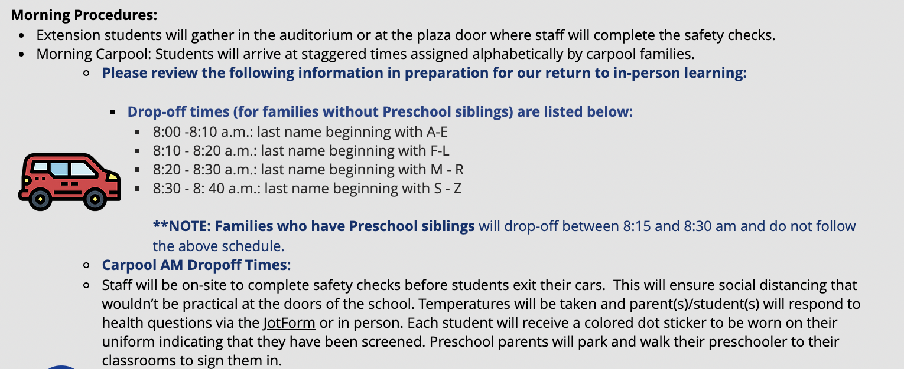
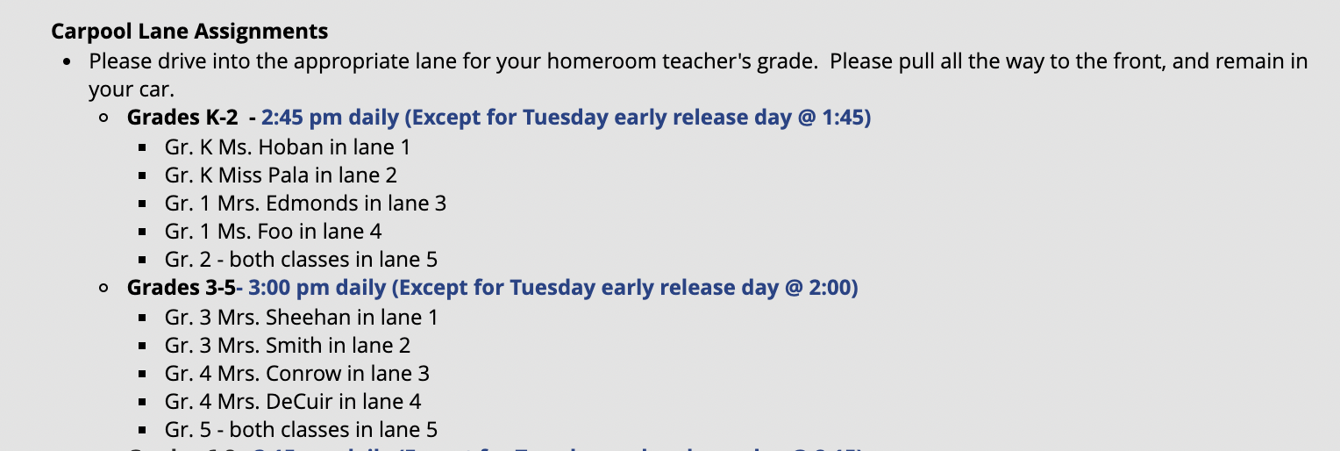
Carpool
Morning
This can be found on the homepage of the St. Luke Web page.
End of Day

Slide 3
Our focus this year will be on building joy in our larger community, school, classroom, and family.

Slide 4
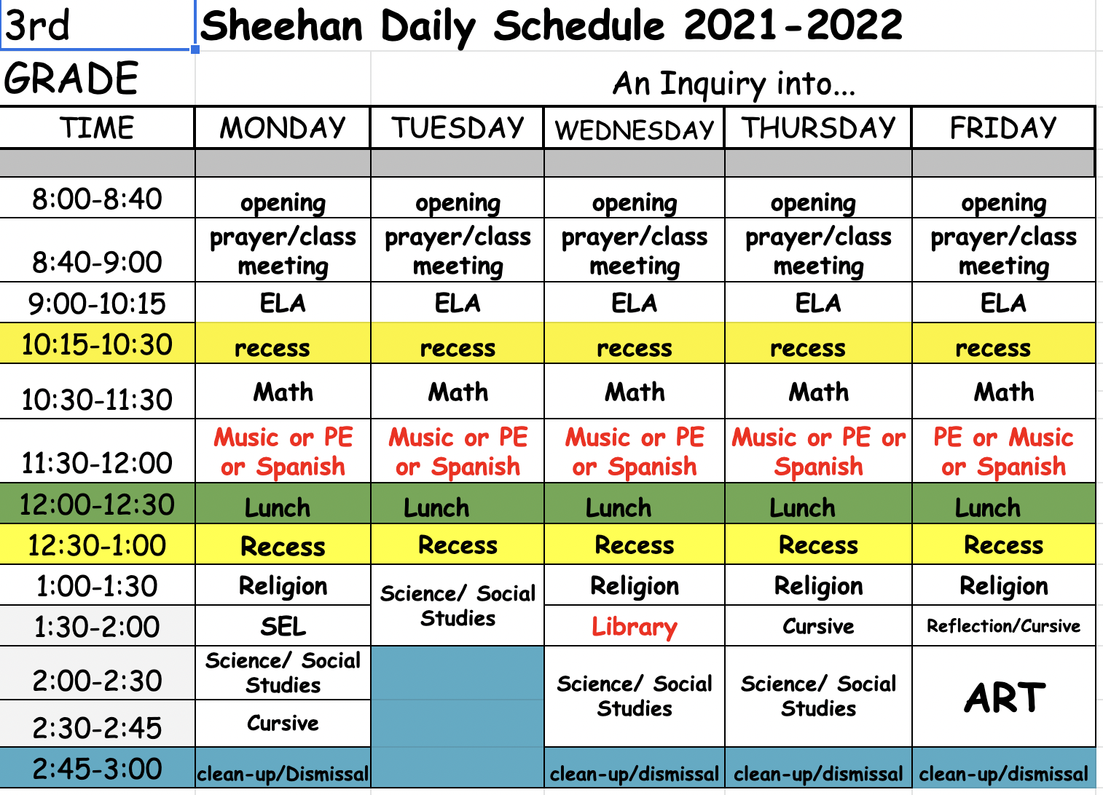
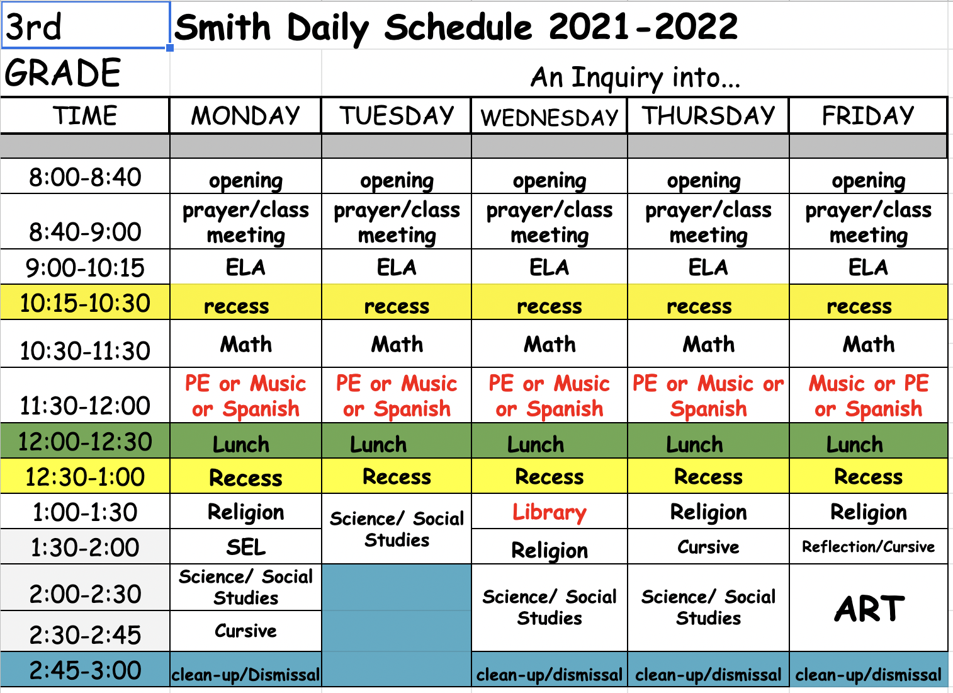
*Schedule and Teachers**
s
Music Mrs. Dirka
PE Mrs. Diaz 3rd Grade Math Standards: Mrs.Sheehan and Mrs. Smith
Spanish Senora 4th Grade Math Standards: Mrs. Sheehan, Mrs. Smith or Mr. Carson
Library Mrs. Feucht

Slide 5
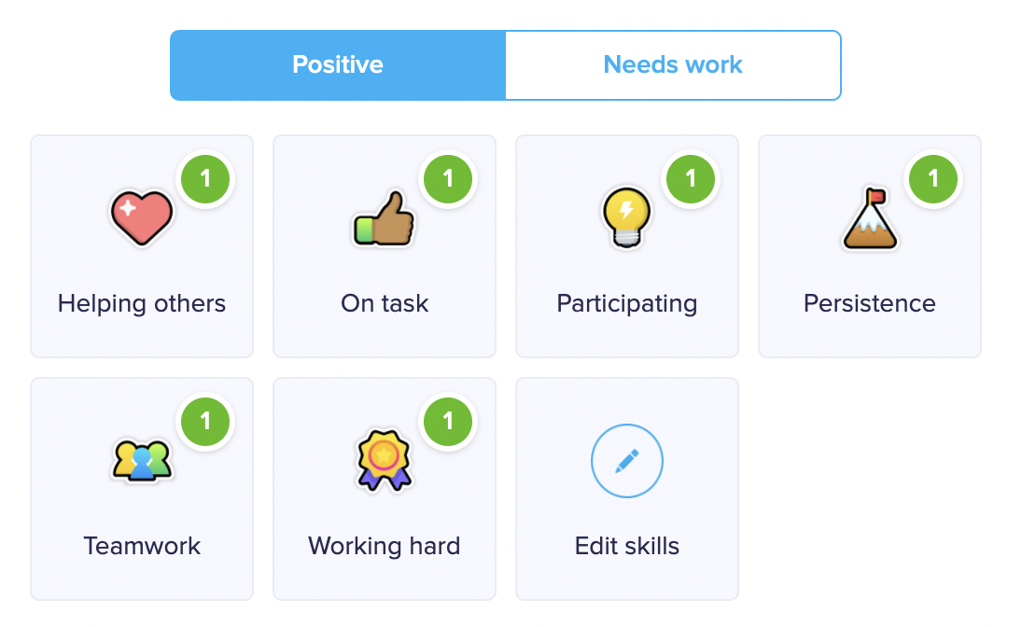
CLASSDOJO
Each student has his or her own avatar. When the students are displaying positive behavior in class i.e. coming to class prepared, being on task, being a good friend and leader, as well has improving scores on Quick Recalls(Mad Minutes) their avatar receives Dojo Points. The class has set a goal of 1000 points and then they can decide on a class party. However, if the students are displaying negative behavior i.e. talking out of turn, disrespecting property or others, not doing their work, their avatar loses points.
If the students lose Dojo Points there are consequences:
Loss of 1 Dojo Points = warning, a reminder to get themselves back on track
Loss of 3-4 Dojo Points = teacher’s choice, here the teacher decides what action to take, very likely that will be loss of recess or other free choice time or completing a behavior reflection sheet.
Watch for email asking you to join and see what is happening in the classroom!

Slide 6
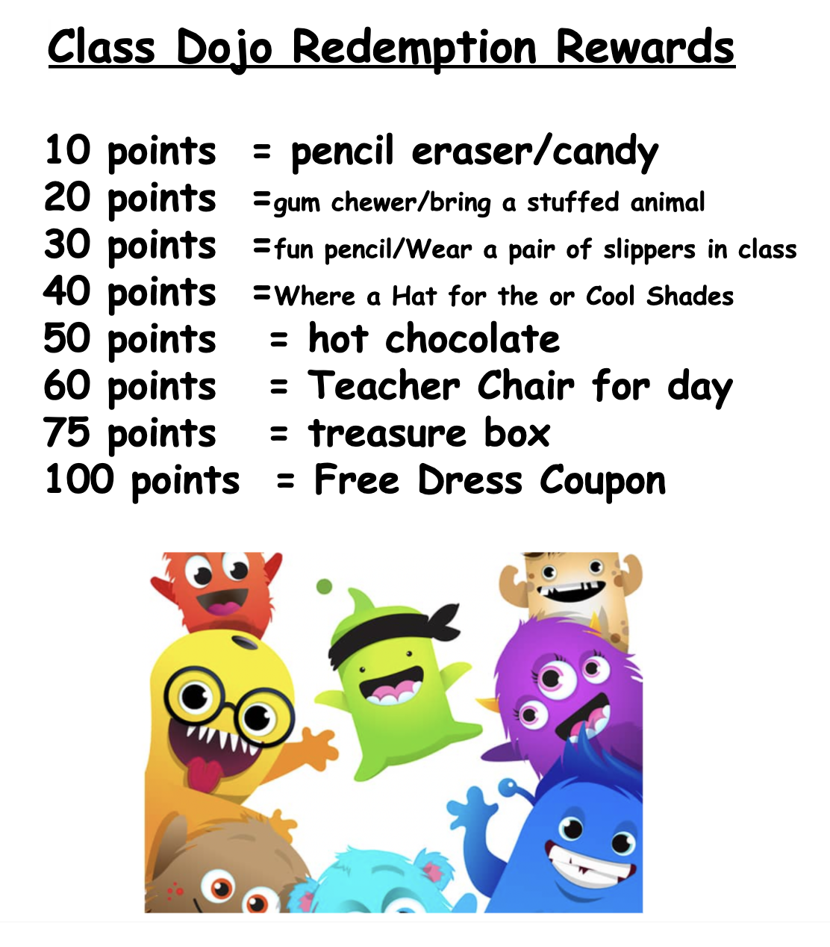
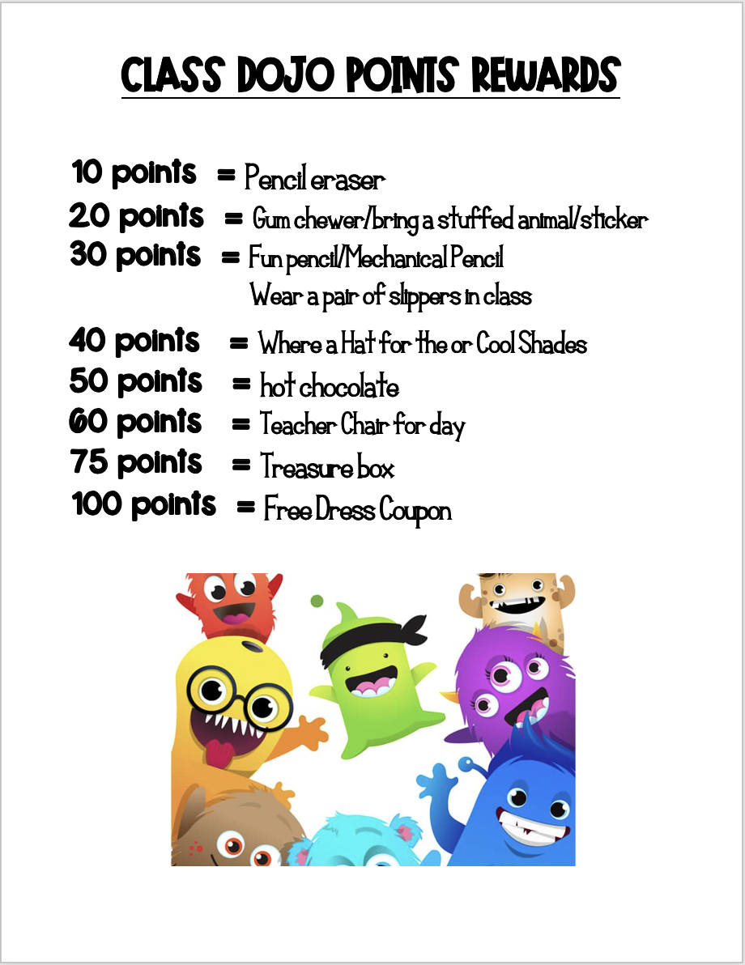
Individual Class Reward
Mrs. Sheehan’s Class Mrs. Smith’s Class
Class plans party when
Total Dojo Points reach:
1st party: 1000
2nd party: 3000
3rd party: 6000
4th party: 9000

Slide 7
**ABSENTEE AND NO NAME FILE **
We will fill out a absentee form and send home missed work with a sibling or place up at the office.
But
if your child needs a copy of an assignment because they lost it or it was eaten by the dog, we have a few extra copies and they will need to complete a new page..
NO NAME papers are kept in special folder.
**BINDERS **
Binders have one folder attached. The folders two pockets are labeled- Parent Attention and Homework/unfinished work.
Student planners are hooked and have a binder clip to keep them on the correct week.
Only take out what has been put in the Parent Attention section of the folder.
** Tuesday Take Home Folder**
Purpose: To ensure that you can review your child's work, one folder will be collected from each child to be used as a Tuesday Take Home Folder.
Goal: All papers handed back to your child to be placed in their folder and the folder taken home every other Tuesday.
Your Responsibility: Remove papers from folder, sign the chart on the back, and make sure the folder is brought back to school Wednesday for class dojo points.

Slide 8
**Homework** 15-45 min.
Reading: All children are required to read every night and when a book is
finished to take an AR test on it.
3rd grade needs 5 AR points a trimester
Math: A Homework worksheet when handed out.
3rd Grade: Addition/Subtraction Basic Facts
(then add multiplication/division after we learn them)
4th Grade: Multiplication/Division Basic Facts
ALEK is our online program that you can have your child
work on at home. To receive the optimum benefit
from ALEKS it is recommended that the children
complete 2 hours a week. Some time will be given
at school to get to this goal
Spelling: One spelling practice sheet/activity should be completed nightly (M-Th).
If you and your child have another way you like to study spelling please come and
talk to me about it.
IB (Social Studies/Science)/Religion
When the opportunity arises, we will send home activities and ways
to enhance learning for these subjects. Throughout the year, the
children will have projects that will require at home work. Big
Projects will be broken down with mini deadlines to keep the children
on track.
Homework is not included in their overall grade but each piece of homework is
given Classdojo points and rewarded for being completed.
Notes:
Slide of Essential Agreements

Slide 9
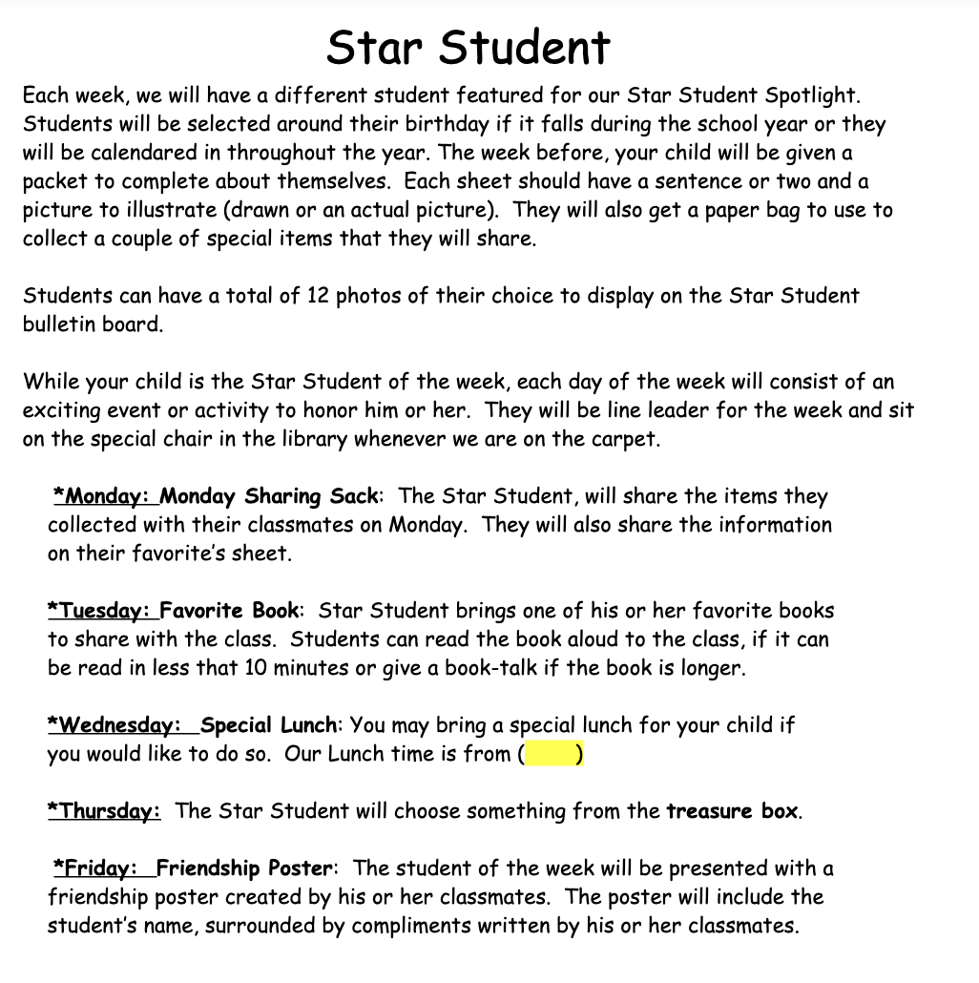
**Star Students**
•Tried to match up close to birthdays and for those who have a birthday during the summer I gave them a random week. I created the first Star Student Display
•
* Birthday child gets free dress on their birthday but if your birthday is during the summer, then you can wear free dress on one of the days during your Star Student week. Birthday treats are okay but I am hoping that we can move away from food related treats and have the children bring in a book to add to the library or a game for the game cupboard. If you do decide to send in food please make it something that is easy to pass out. The birthday child will pass it out at lunch time.
Notes:
Slide of Essential Agreements

Slide 10
*Water Bottles
** Heads phones
***Healthy snacks
***Please don't bring pop/soda to school. We will save that as a
special treat on Star Student Day or a Party Day
Thanks for Coming!
It's Going to Be a Great Year!
Any Questions?

