Slide 1
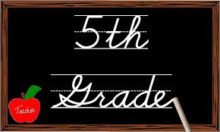
Welcome to 5th Grade
With Mrs. Smith &
Ms. Bakamis

Slide 2
Approaches to Learning
Thinking Skills
Social Skills
Communication Skills
Self-Management Skills
Research Skills

Slide 3
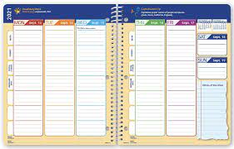
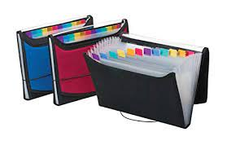
Organization & Classroom Economy
Filers/Pendaflex
Planners
Classroom Economy

Slide 4
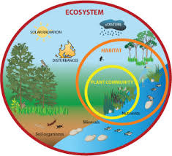
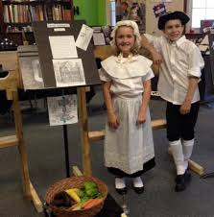
IB Units – 1st Trimester
Science 1 – Organic matter cycles through our living world in systems of interdependent parts. (Ecosystems & the Food Chain)
Social Studies 1 – Culture, trade, & geography played a part in the formation of the 13 colonies. (Colonization)

Slide 5
IB Units – 2nd Trimester
Science 2 – Water is essential to life & is a limited resource for many people. (Water conservation). Exhibition!
Social Studies 2 – Different perspectives can cause conflict. (Revolutionary War)

Slide 6
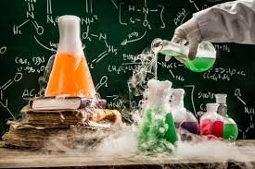
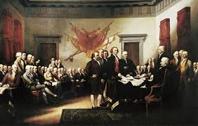
IB Units – 3rd Trimester
Science 3 – Chemical reactions enable us to make new materials by transforming the ones we have. (Chemical reactions)
Social Studies 3 – Liberties come with responsibilities. (Forming a Nation)

Slide 7
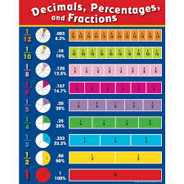
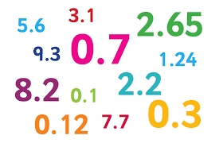
Math
Foundational skills currently working on
Independent Practice – in class
Homework – additional practice at home
ALEKs expectations of 5 topics per week
Preparing the students for Math Pathways in Middle School

Slide 8
Writing & Grammar
Frequent writing assignments
Narrative writing
Informational writing
Persuasive Writing
Research tied to IB units

Slide 9
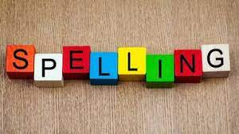
Reading & Spelling
Flexible reading groups tied to IB units
Nightly reading expectation of 30 minutes
AR: 15 points per trimester
Weekly spelling tests at their own level

Slide 10
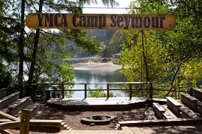
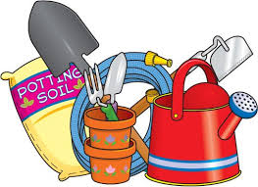
Exciting Opportunities
Camp Seymour
Garden time with
Mrs. Ramos &
Mrs. Sullivan
Robotics with Mr. Huntamer

Slide 11
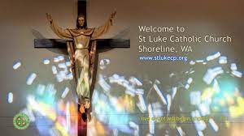
Religion
Seven Sacraments
Beatitudes
Service Opportunities
Masses

Slide 12
Assessments
Acquisition
Meaning-Making
Transfer

Slide 13
Any Questions?
Thank you for coming.

